Slide 1
Week 3: Methods to identify the right product

Slide 2
Agenda
Recap of last week’s session: Being Agile, Scrum and Kanban, Mock project & product team Product Discovery/Opportunity Assessment: Mission Model Canvas, Value Proposition Canvas
Customer Discovery: User Research, Journey Mapping
Where do we go from here: Project RevAMPD
Notes:
The goal for today is to show how all of the product and research areas that we’ve been working on fit together to help identify the highest value steps in a product’s development. At the end we’ll apply allot these areas to RevAMPD to help give the mock project structure.

Slide 3
Recap of last week’s session
Being Agile - Agile principles and values
Scrum and Kanban
Mock project and product team

Slide 4
Individuals and interactions over processes and tools
Working software over comprehensive documentation
Customer collaboration over contract negotiations
Responding to change over following a plan
AGILE MANIFESTO - KEY TAKEAWAYS

Slide 5
AGILE VALUES
Customer satisfaction
Frequent delivery
Welcoming change
Working software
Technical and design excellence
Simplicity
Cross-functional teams
Self-organizing teams
Reflecting frequently

Slide 6
Project details
What we’re planning to do: Redesign AMPD
Why a ‘mock’ project:
To practice the lessons and principles we’re learning and experience them first-hand
To gain confidence to lead with a product mindset when the vendor is on board
Simulate scenarios for the teams to react to
What we’re not trying to do:
Have a design or an MVP ready for the vendor to execute
Aim for a finished product
Repeat exercises we’ve conducted in the past (visioning, personas, etc.)

Slide 7
Cross-functional product team
Product Owners
Jason, Joe K
Subject Matter Experts
Craig, Chris, Mike H
Strategy/Design/UX
Andrew, Garrett, Michelle
Engineering
Mike, Joe T, Thuy
Acq and Project Management
Kim, Laurie

Slide 8
What about Agile seemed challenging for your teams?
What about Agile seemed exciting and welcome for your teams?
DISCUSS
Notes:
This fit is generally termed as product market fit

Slide 9
Product Discovery

Slide 10
To understand the beneficiaries and collect ‘evidence’ to support the need to develop a product
WHY DO WE NEED PRODUCT DISCOVERY?
Notes:
This fit is generally termed as product market fit

Slide 11
To help the product team align and measure their work in terms of the value delivered by shared learning about the beneficiary
WHY DO WE NEED PRODUCT DISCOVERY?
Notes:
This fit is generally termed as product market fit

Slide 12
To address:
Value risk: Will the beneficiary choose to use this product?
Usability risk: Will the user know how to use this product?
Feasibility risk: Can we build this product?
Business viability: Will this solution work for our business?
PURPOSE OF PRODUCT DISCOVERY
Notes:
This fit is generally termed as product market fit

Slide 13
Understanding your beneficiaries

Slide 14
User research is gathering insights on your users, focusing on key elements such as user behaviors, motivations, needs, and pain points.
WHAT IS USER RESEARCH?

Slide 15
User research brings the focus and guidance of product development back to where it’s due: the users.
WHY DO YOU NEED USER RESEARCH?

Slide 16
Design better products
Mitigate usability and value risks
Validate your product ideas
Save costs, time and effort
WHY DO YOU NEED USER RESEARCH?

Slide 17
Discovery Methods

Slide 18
User Interviews
Personas
Journey Maps
A FEW USER RESEARCH METHODS
Notes:
Interviews: One-on-one discussions with users to understand how a particular user works. They enable you to get detailed information about a user’s attitudes, desires and experiences.To build consensus about the problem statement and research objectives
Personas are fictional characters based on our research. They represent user types that might use your service, tool, product or site in a similar way. Personas help empathize over the users and are useful to validate our assumptions as we proceed into product development. By creating personas, we were able to move away from distinct user groups and instead think about our user behaviors.
A visualization of the major interactions shaping a user’s experience of a service or a product. To provide teams with a bird’s-eye view of a service that helps them see the sequence of interactions that make up a user’s experience including the complexity, successes, pain points, and emotions that users experience along the way

Slide 19
To provide teams with a bird’s-eye view of a service in order to see the sequence of interactions that make up a user’s experience including the complexity, successes, pain points, and emotions that users experience along the way.
WHY DO WE NEED JOURNEY MAPS?
Notes:
This fit is generally termed as product market fit

Slide 20
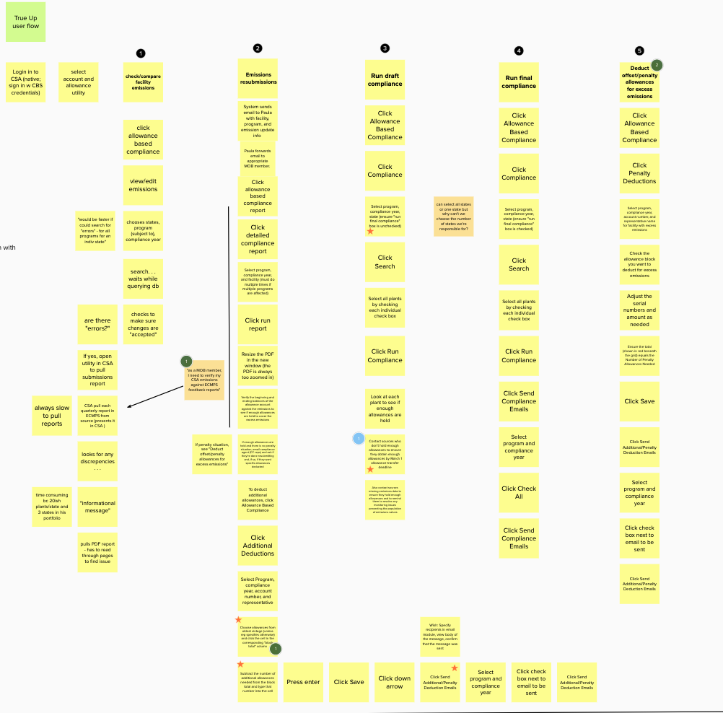
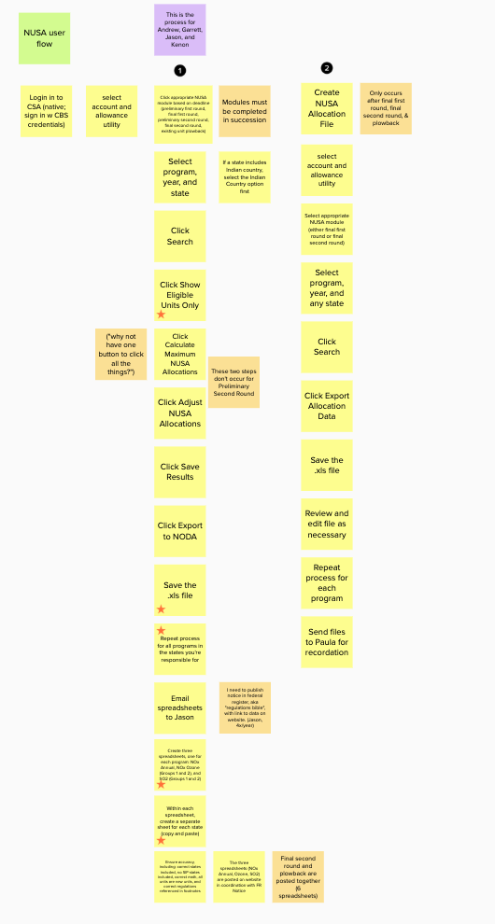
CAMD SUITE - USER FLOWS
Notes:
[at this moment open up for some participation/discussion? Maybe invite Garrett and Andrew to talk about their experience w doing this work?]

Slide 21
Opportunity Assessment

Slide 22
Mission Model Canvas

Slide 23
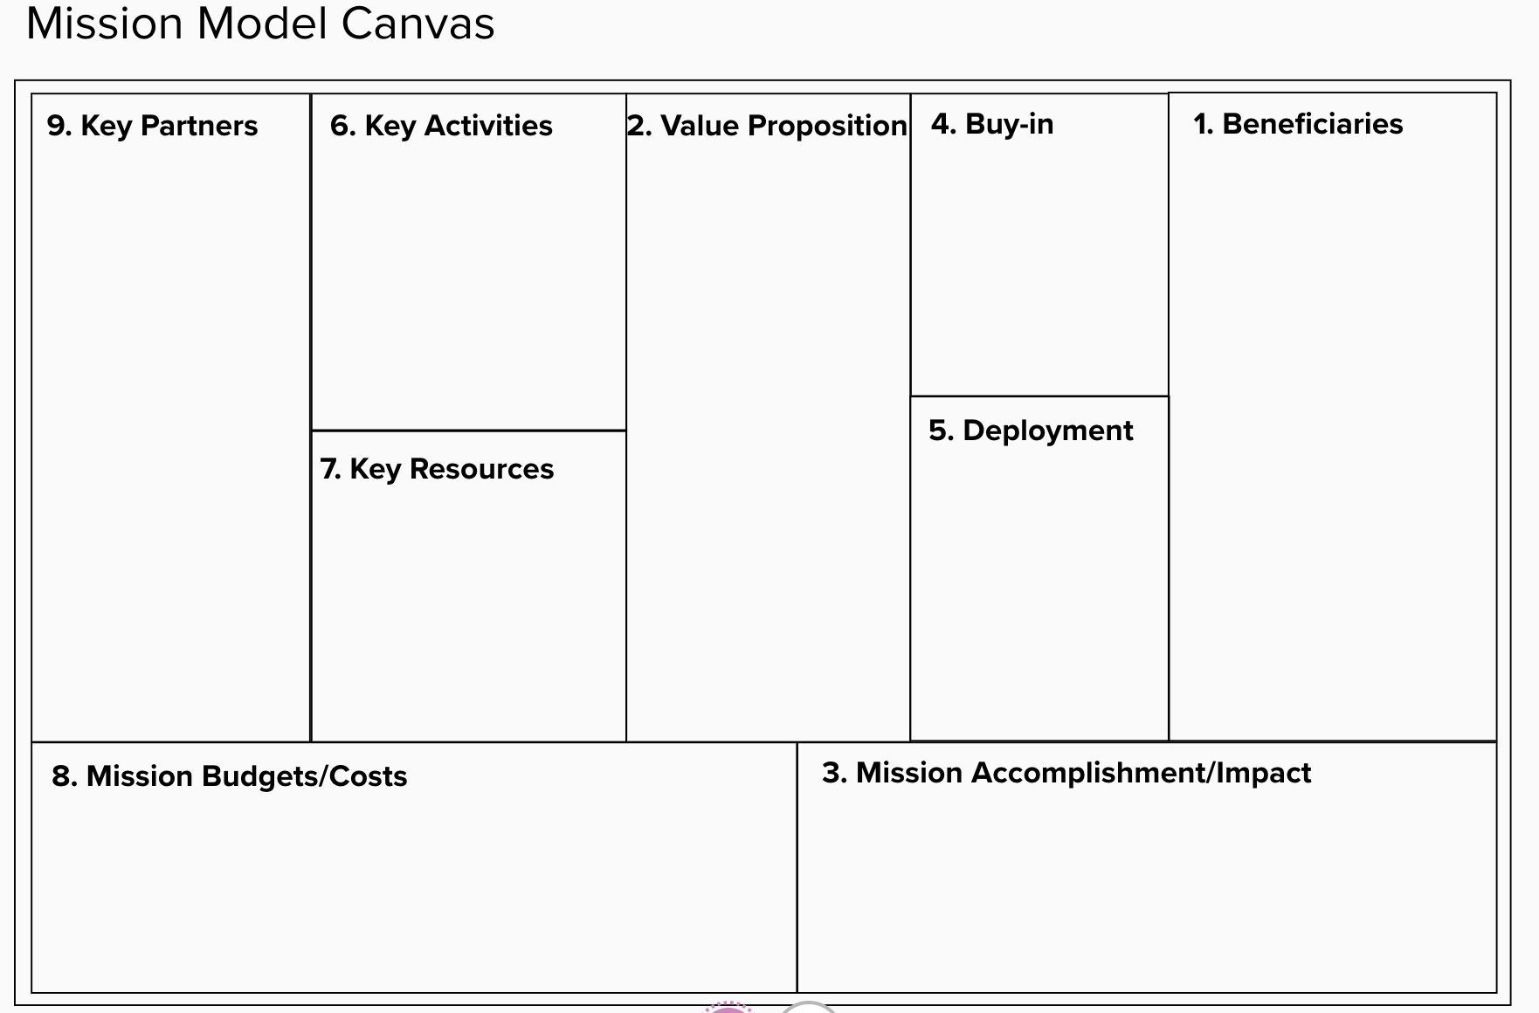
WHAT IS A MISSION MODEL CANVAS?

Slide 24
A Mission Model Canvas is a framework to collect insights about your product/mission in a structured way
WHAT IS A MISSION MODEL CANVAS?

Slide 25
It consists of 9 sections:
Beneficiaries
Value proposition
Mission accomplishment/impact
Buy-in
Deployment
Key activities
Key resources
Key partners
Mission costs
WHAT IS A MISSION MODEL CANVAS?

Slide 26
A Mission Model Canvas collates information about the customers and beneficiaries, the value proposition, impact, and costs of the product.
WHAT IS A MISSION MODEL CANVAS?

Slide 27
It illustrates the search for the unknowns.
WHAT IS A MISSION MODEL CANVAS?

Slide 28
The right side of the canvas represents value and the left side of the canvas represents costs and activities needed to deliver value.
WHAT IS A MISSION MODEL CANVAS?

Slide 29
It visualizes all the components needed to turn customer needs/problems into mission success.
WHY USE A MISSION MODEL CANVAS?

Slide 30
It describes the rationale on how the product is creating value to its beneficiaries
WHY USE A MISSION MODEL CANVAS?

Slide 31
It brings out the strengths, weaknesses, opportunities and threats to the forefront prior to execution.
WHY USE A MISSION MODEL CANVAS?
Notes:
Also highlights the risks

Slide 32
It’s flexible, easy to understand, and centered around the customer and value.
WHY USE A MISSION MODEL CANVAS?

Slide 33
It helps assess the current state of affairs in preparation for execution.
How scalable is the current model?
How dependent are we on work done by others?
What external factors affect the mission model?
WHY USE A MISSION MODEL CANVAS?

Slide 34
A few common pitfalls:
Irrelevant customer jobs
External threats
Poor execution
COMMON PITFALLS THE CANVAS HELPS AVOID
Notes:
Execution can include infrastructure issues

Slide 35
A few questions that can help identify pitfalls:
Are you helping the customer do a job they need or want? Is the customer job relevant?
Do you have the right model? Is it scalable?
Does your team have the right skills? Can they acquire the right skills?
QUESTIONS TO HELP IDENTIFY THESE PITFALLS
Notes:
Eg: Segway

Slide 36
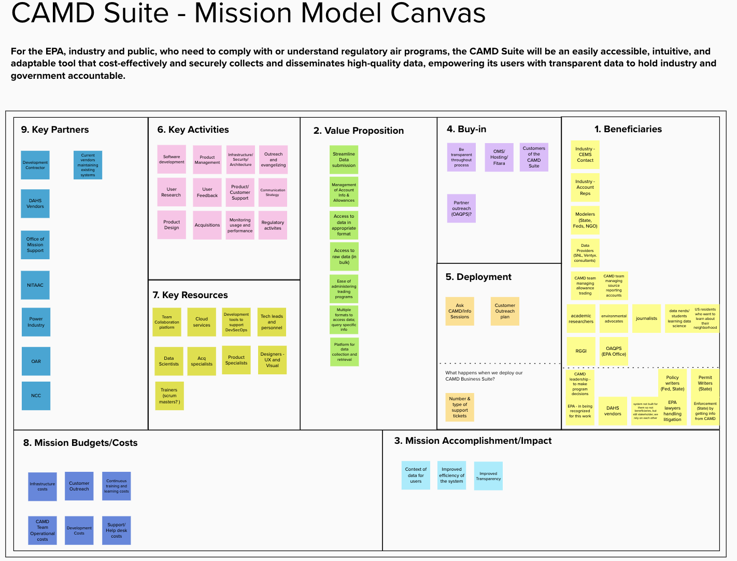
CAMD SUITE - MISSION MODEL CANVAS
Notes:
Execution can include infrastructure issues

Slide 37
Project RevAMPD

Slide 38
Previously on RevAMPD
Project Name: RevAMPD
Our scrum master: Chris W
Our sprint cadence: 2-week sprints
Sprint planning: Tuesdays
Daily stand-up: Daily
Sprint review: Mondays
Sprint retro: Mondays
Kanban board: MS Teams Kanban board
Team charter

Slide 39
Next up on RevAMPD
User research - UX team
Plan user research for RevAMPD
Conduct mock interviews where 18F team plays the ‘user’ role
Refine AMPD personas based on learnings from the interviews
Draft a Journey Map in collaboration with the SMEs
Develop Mission model canvas of RevAMPD - Product team led by PO
Develop Value Proposition Canvases for RevAMPD
Customer profiles - UX team
Value proposition - Product Owners and subject matter experts

Slide 40
Suggested reading/viewing
Business Model Canvas
Canvas Explained
Example
Product Discovery

Slide 41
Thank you!

